Slide 1
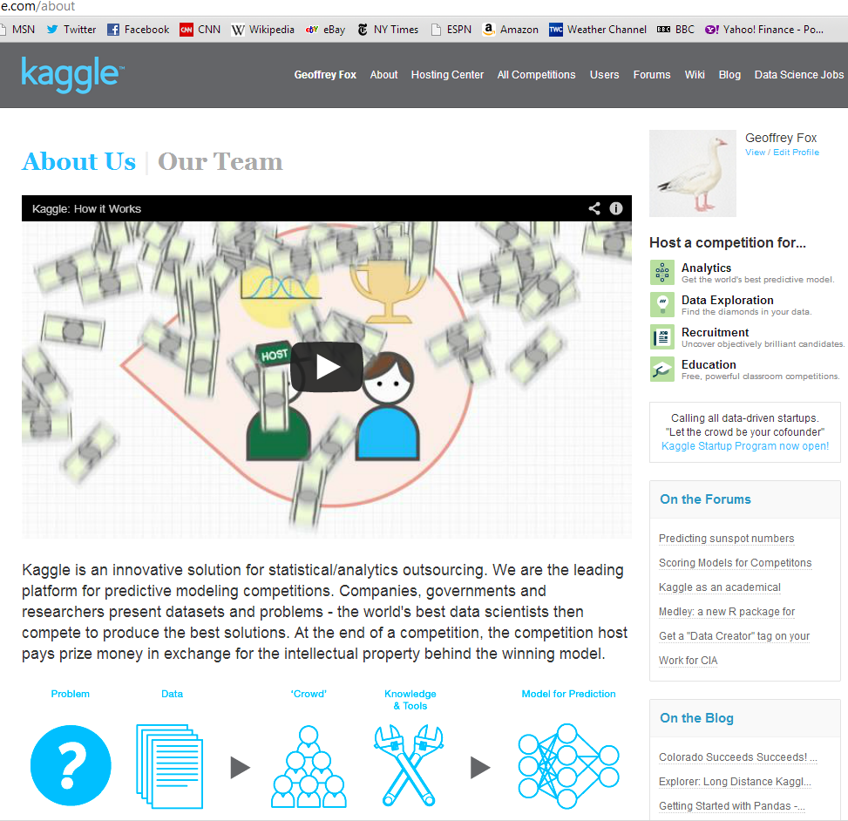
http://www.kaggle.com

Slide 2
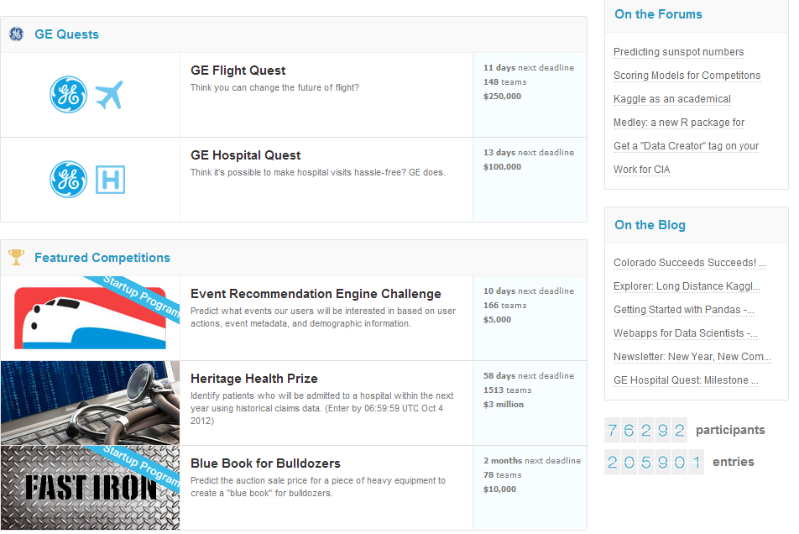

Slide 3
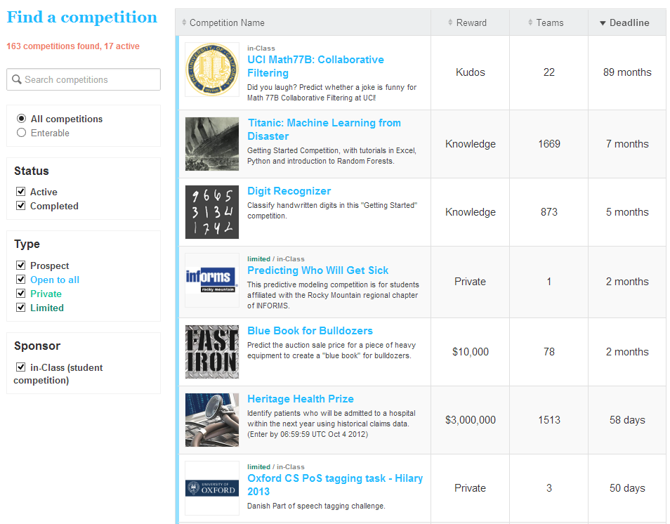

Slide 4
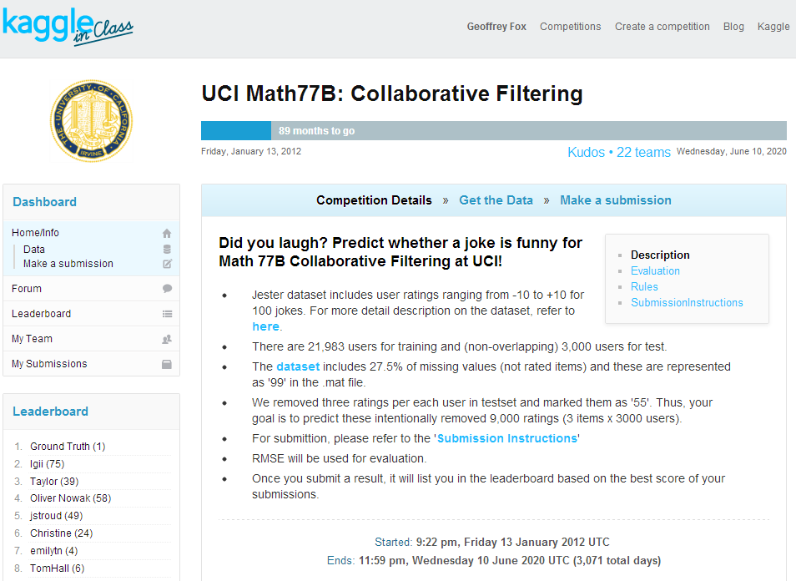

Slide 5
UCI Recommender Examples
Amazon.com (Search for your favorite book and look at what other books are recommended)
Bing or Google (Search for computer and view the ads that are displayed)
Netflix (If you have an account see how netflix recommends new movies to you)
Jester (Try it out and rate some jokes)
MovieLens from Univ. Minnesota. Find Movies you like
Pandora (Try adding some songs and observe what it plays for you) Watch this Time Video on the Pandora Recommender System (Then check out that Time Video webpage and observe it is recommending related videos ....)
Y! Music Yahoo Music Site
StumbleUpon (Watch this short video) Recommends web sites
YouTube (Observe how it recommends new video based on what you watched before)
and many, many more......
http://www.ics.uci.edu/~welling/teaching/CS77Bwinter12/CS77B_w12.html
http://www.time.com/time/magazine/article/0,9171,1992403,00.html Time magazine on Recommender systems

Slide 6
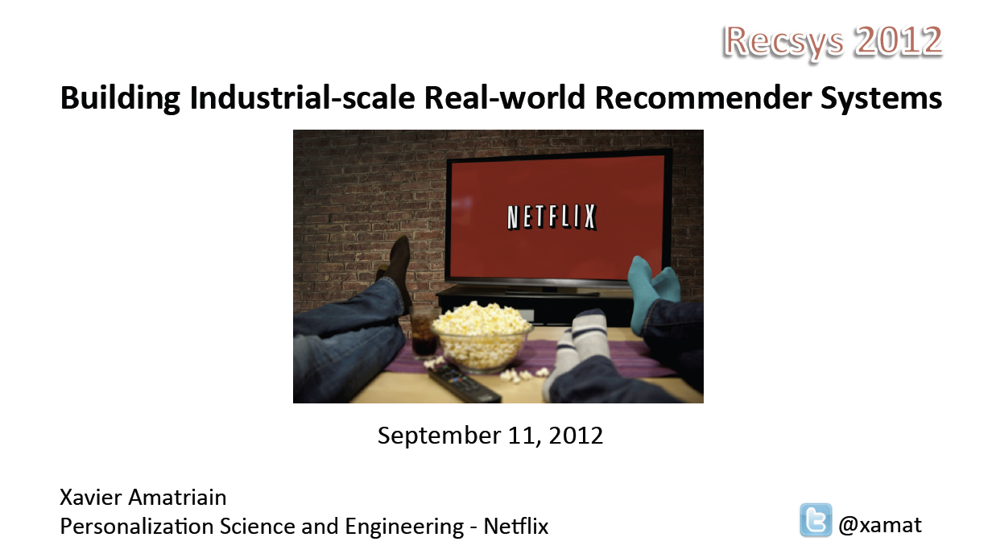
http://www.slideshare.net/xamat/building-largescale-realworld-recommender-systems-recsys2012-tutorial

Slide 7

http://www.slideshare.net/xamat/building-largescale-realworld-recommender-systems-recsys2012-tutorial

Slide 8
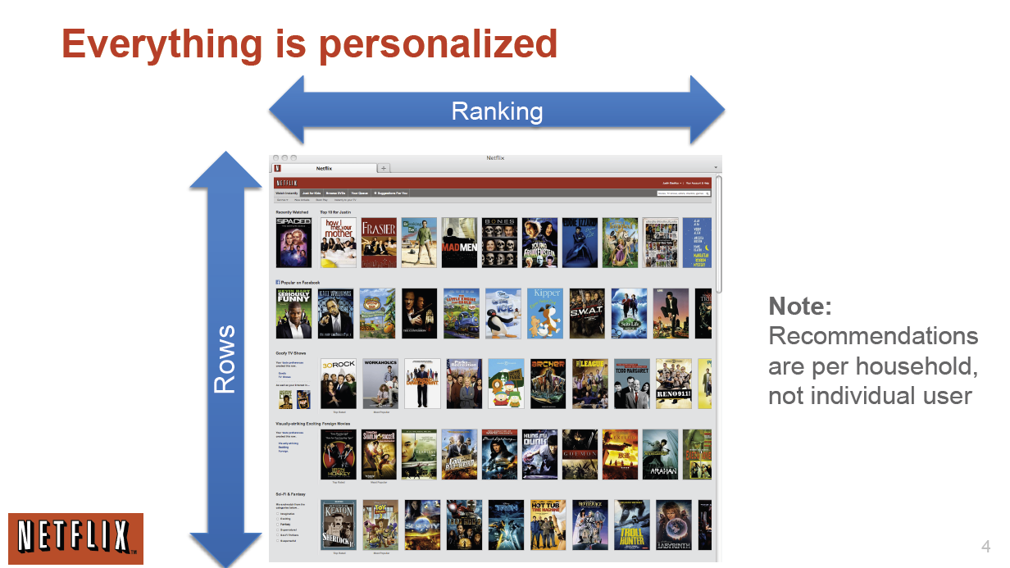
http://www.slideshare.net/xamat/building-largescale-realworld-recommender-systems-recsys2012-tutorial
See comment at end

Slide 9
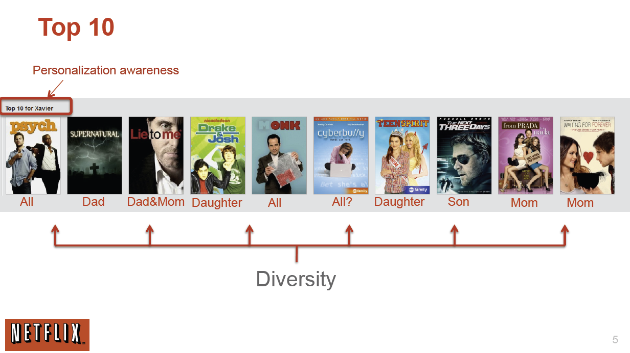
http://www.slideshare.net/xamat/building-largescale-realworld-recommender-systems-recsys2012-tutorial

Slide 10
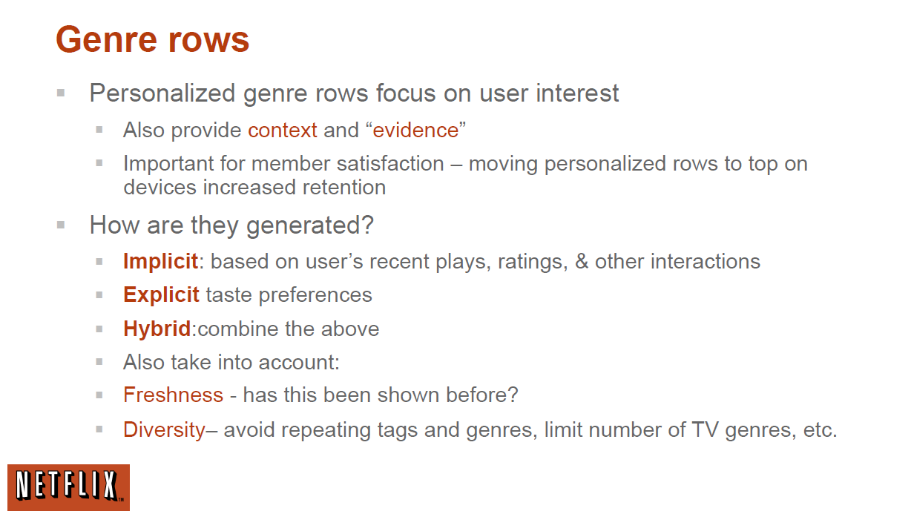
http://www.slideshare.net/xamat/building-largescale-realworld-recommender-systems-recsys2012-tutorial

Slide 11
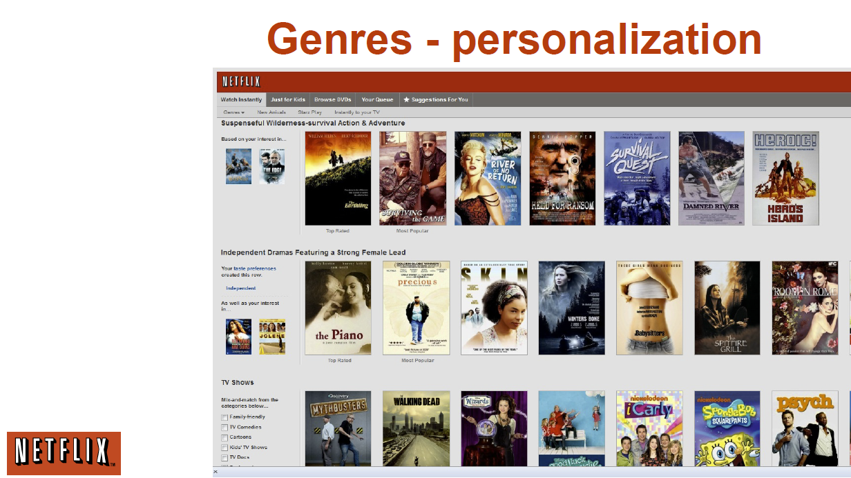
http://www.slideshare.net/xamat/building-largescale-realworld-recommender-systems-recsys2012-tutorial

Slide 12
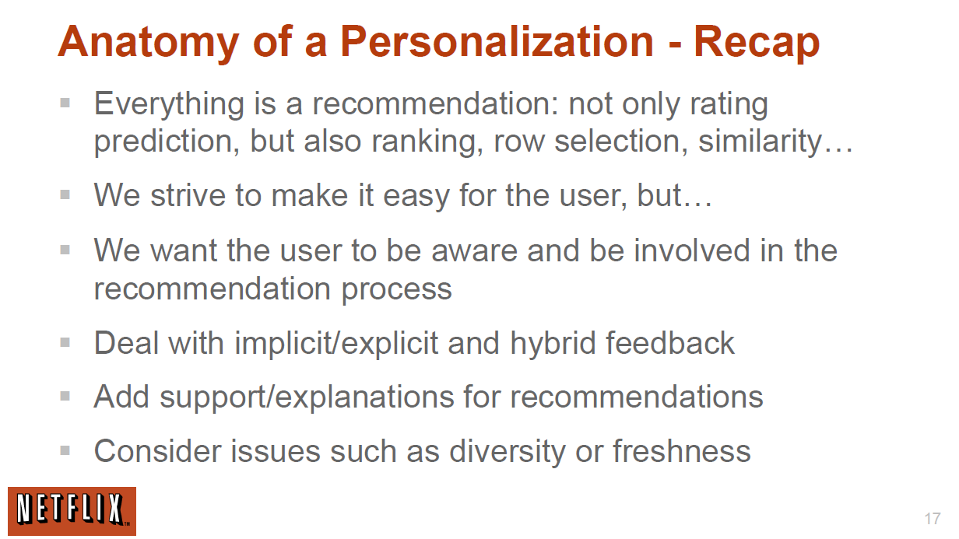
http://www.slideshare.net/xamat/building-largescale-realworld-recommender-systems-recsys2012-tutorial

